Slide 1
Second Project
Due Sunday, May 1 @ 11:59 via Blackboard

Slide 2
Tools and Expectations
Use Access and Excel to produce the following reports and forms.
Each product should be in the format as shown in the examples. Please notice the format of the data for each report as shown in the examples.
While each report’s data should be extracted from your Access database with a query, the report should be completed and submitted in Excel. Save the query used for each report in your Access database so I can review them.
Calculations must be done by formulas and functions using appropriate relative and absolute cell referencing or named ranges. No hand keying of information or results will be accepted.
Each spreadsheet should be professionally done including titles, column headings, totals, author, date, time and source.

Slide 3
Get the required Excel files (Second Project Data) and incorporate them into an Access database named Second Project Database. Establish the necessary relationships between the tables with the appropriate primary and foreign keys. The Excel workbook Second Project Data contains the necessary data in spreadsheets The following sheets are to be incorporated into your Access database:
Monthly Income by Unit
Monthly Expense Summary
Building Space Inventory
Tenants by Unit
Tenant Information

Slide 4
Please produce the following tables/form:
Monthly Rent Summary
Monthly Expense Summary
Tenants by Unit with Name and Phone Number
Expense Divided by Income by Month
Create a Data Entry Form for Tenant Information

Slide 5
Monthly Rent Summary
Monthly Rent Summary
 | Unit Number
Month | Unit 0 | Unit 1 | Unit 2 | Unit 3 | Unit 4 | Unit 5 | Unit 6 | Unit 7 | Unit 8 | Unit 9 | Unit 10 | Unit 11 | Totals
January | $0
February
March
April
May
June
July
August
September
October
November
December
Totals
Source:
Date:
Time:
Author:

Slide 6
Monthly Expense Summary
Monthly Expense Summary
Expense Categories
Month | Repairs | Insurance | Mortgage | Electric | Water Bill | Totals
January | $0.00
February
March
April
May
June
July
August
September
October
November
December
Totals
Source:
Date:
Time:
Author:

Slide 7
Tenants by Unit with Name and Phone Numbers
Tenants by Unit with Name and Phone Number
Unit | Last Name | First Name | Phone Number
0 |  |  | (XXX) XXX-XXXX
1
2
3
4
5
6
7
8
9
10
11
Source:
Date:
Time:
Author:

Slide 8
Expense Divided by Income by Month
Expense Divided by Income by Month
Month | Expense Totals | Income Totals | Expense/Income
January | $X.XX | $X.XX | XX%
February
March
April
May
June
July
August
September
October
November
December
Totals
Source:
Date:
Time:
Analyst:

Slide 9
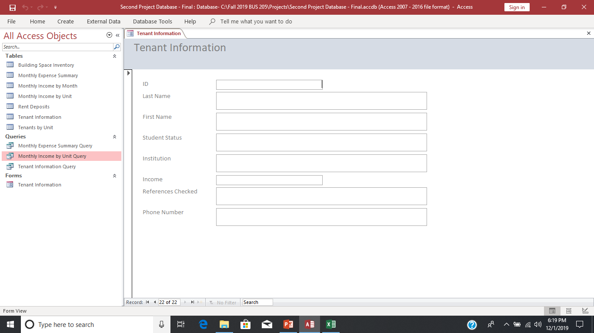
Create a Data Entry Form for Tenant Information

